Slide 1

Hierarchical Clustering
Understanding Data Relationships Through Hierarchies
Presented by Miraj Deep Bhandari

Slide 2

What is Hierarchical Clustering?
Intuitive Grouping
Nested Structure
Organizes data into a family-tree of related clusters.
Shows how small groups fit into larger categories.
Visual Mapping
No Preset Clusters
Uses a dendrogram to reveal relationships.
Explore groupings without fixing their number first.

Slide 3
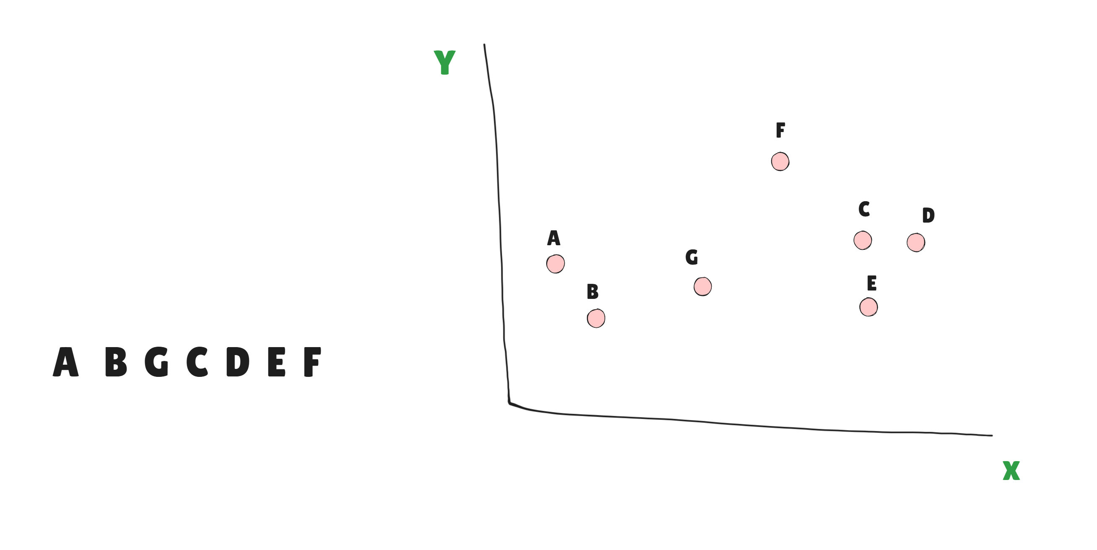

Slide 4
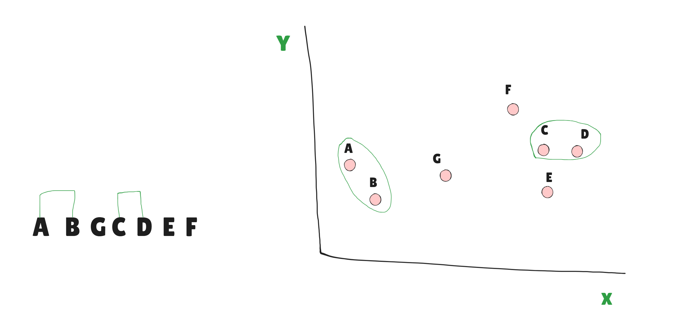

Slide 5
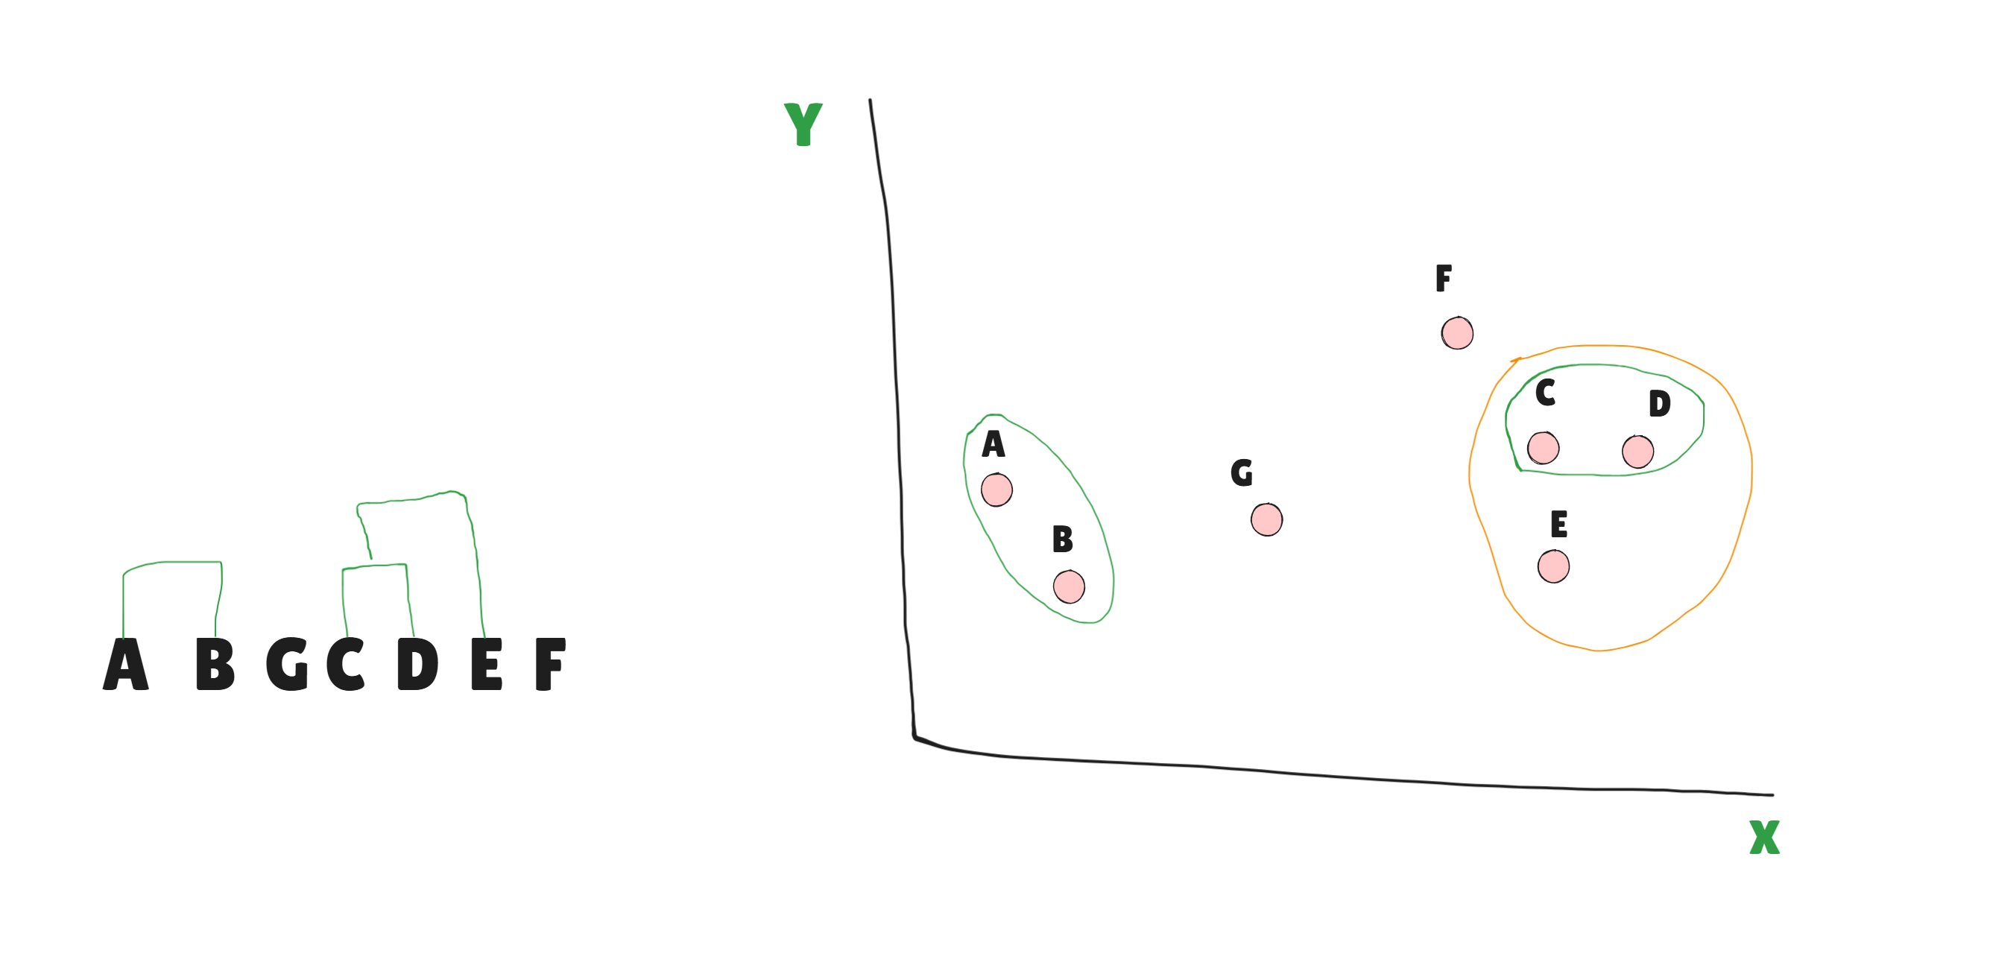

Slide 6
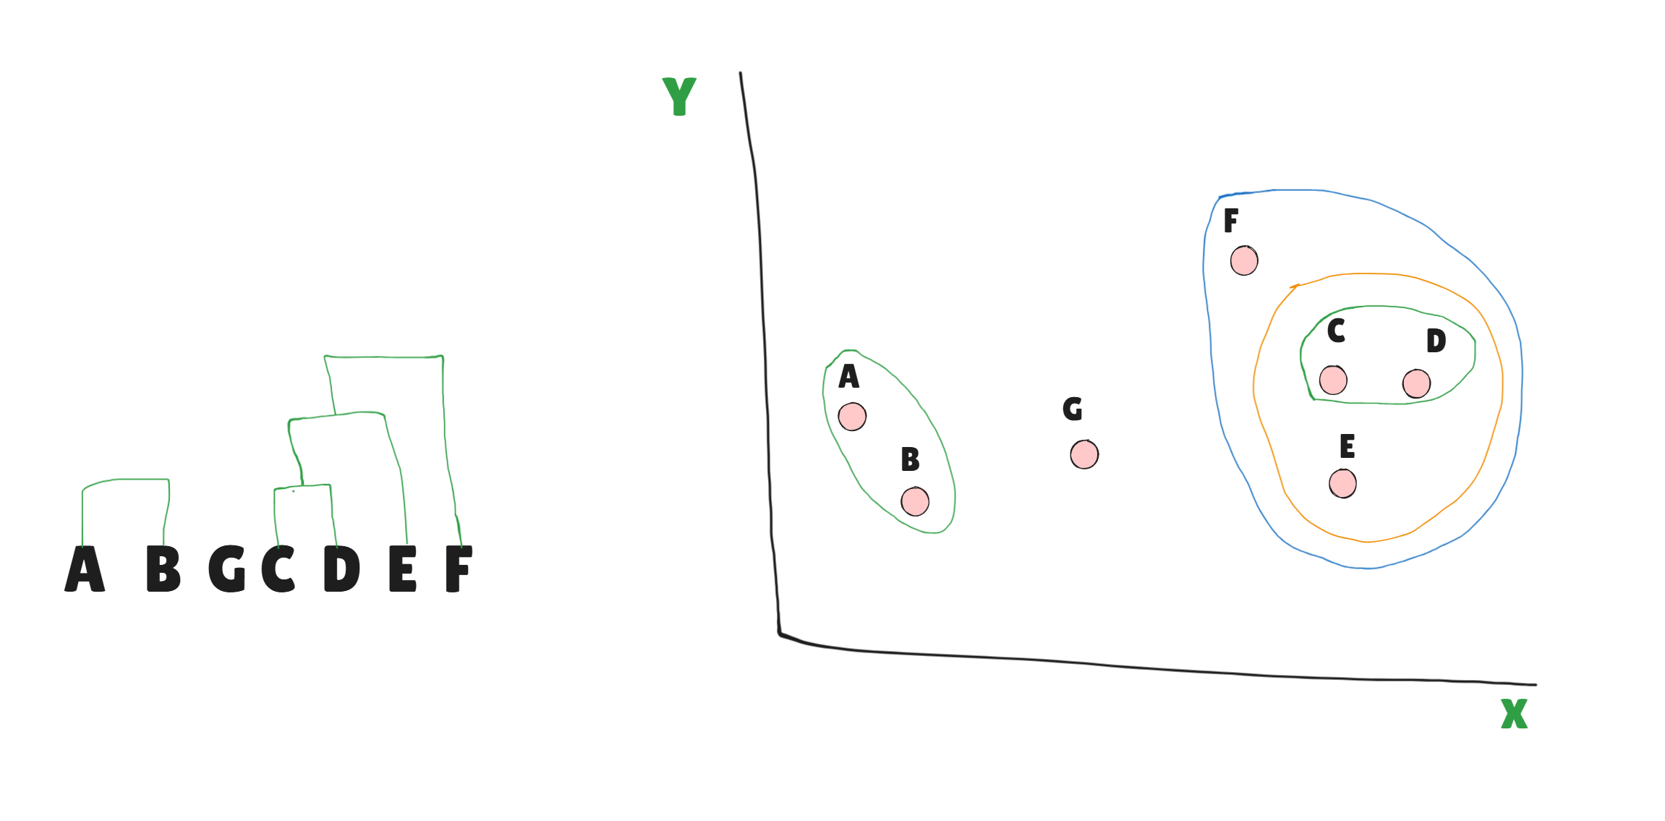

Slide 7
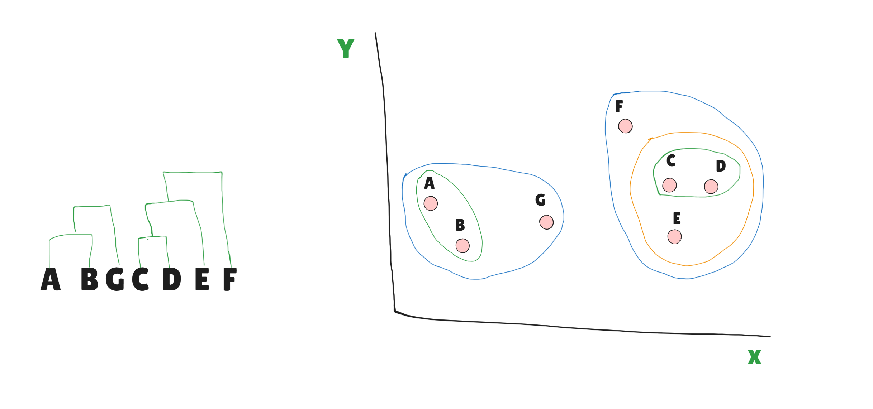

Slide 8
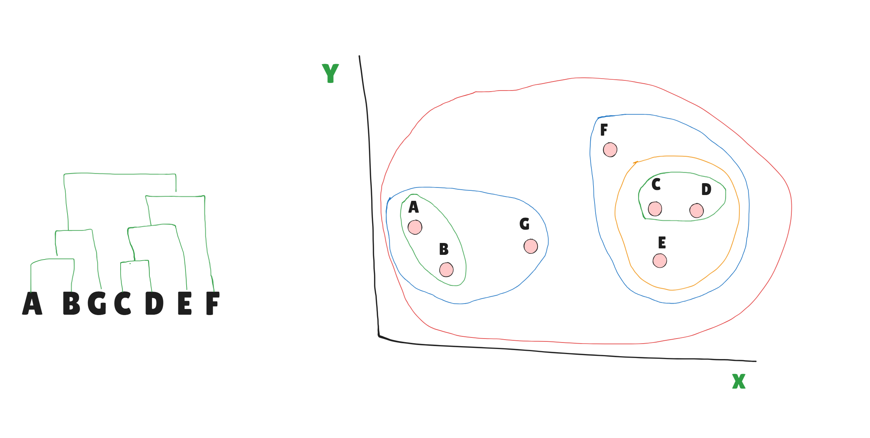

Slide 9
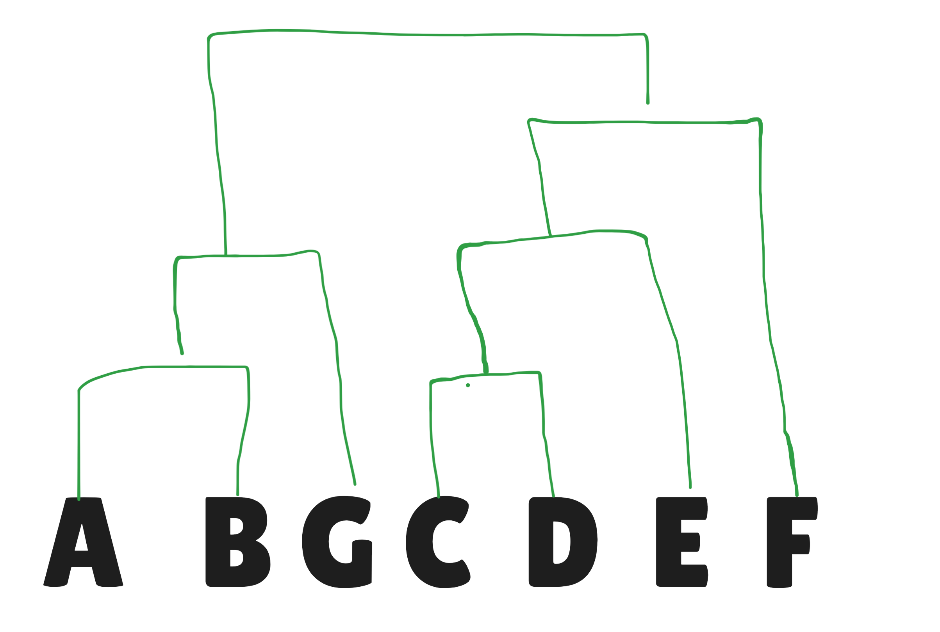

Slide 10
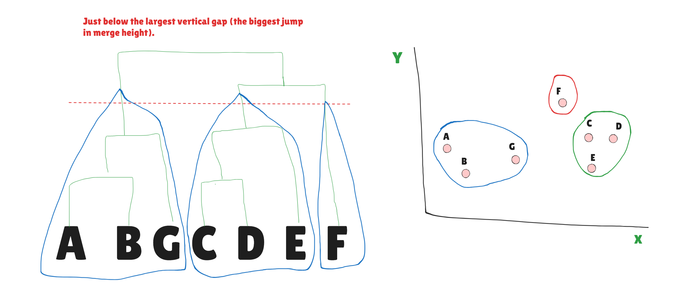

Slide 11

Bottom-Up vs. Top-Down
Agglomerative
Divisive
The "Bottom-Up" Strategy
The "Top-Down" Strategy
Starts with each data point as its own individual cluster and progressively merges them based on similarity.
Starts with all data points in one single cluster and recursively splits it into smaller ones.

Slide 12

The Dendrogram
Tree Visualization
It visually represents the hierarchy of clusters, showing exactly how individual data points evolve into larger groups.
A dendrogram is a tree-like diagram that records the sequences of merges or splits, providing a complete map of your data's relationships.
Similarity at a Glance
The vertical axis represents distance or dissimilarity. Shorter vertical lines connecting two groups mean they are more similar.
Flexible Choice
You can "cut" the tree at any horizontal level to determine the number of clusters that best fits your specific analysis needs.

Slide 13

Complex Data
Clear Relationships
Why Use Hierarchical?
Better at finding clusters with unusual or non-spherical shapes than simple methods like K-Means.
Shows not just that items are grouped, but exactly how they are related through a nested hierarchy.
Consistent Results
No Guesswork
Provides the same outcome every time you run it on the same data, ensuring reliability in your analysis.
Eliminates the need to guess the number of clusters beforehand, allowing the data to speak for itself.

Slide 14




Real-World Examples
Customer Segments
Biological Trees
Document Filing
Grouping shoppers by their purchasing habits and preferences to create highly targeted marketing campaigns and personalized experiences.
Showing how different species, genes, or proteins are related through evolutionary history, creating intuitive "family trees" of life.
Automatically organizing large collections of digital files or news articles into intuitive folders and subfolders based on content similarity.

Slide 15

Summary: Key Takeaways
Visual & Intuitive
The best choice for exploring data when you don't know the cluster count in advance.
Hierarchy Matters
Reveals the natural "levels" and nested relationships within your data points.
Versatile Tool
A standard technique for pattern discovery across marketing, biology, and data organization.
Thank You

